Slide 1
Muslim Social Reform Movement in Bengal During the Colonial Period
Course: His 101, Bangladesh Culture and Heritage
Muhammad Asif Basar
Lecturer, Department of History and Philosophy
North South University

Slide 2
Introduction:
Socio-religious reform movement within the Muslims society in Bengal and other parts of India emerged very lately in compare to the reform movements of the Hindus. Most Muslims feared that Western education would endanger their religion as it was un-Islamic in character. During the first half of the 19th century, due to the continuous struggles of some prominent Muslim scholars, only a handful of Muslims had accepted English education.
In the early 19th century, the first signs of Muslim awakening appeared under the leadership of Sir Syed Ahmed Khan of Bareilly in U.P. and Shariatullah of Bengal. Due to their constant efforts, the age of reformation movement in the Muslim society started in India.

Slide 3
Reason behind the growth of the reformation initiatives?
Christian Missionary propaganda against the traditional religious and social customs of India. From 1813 onwards restrictions on the activities of the Christians missionaries were removed.
The monopolistic trading rights of the East Indian Company
Impact of English Education
Hindu Religious Reform Movements
Early reform Initiative of Shah Waliullah (1703-1762) in Delhi during the later part of 18th century
External Challenges, such as the rise of Wahabism in the Middle East

Slide 4
Characteristics of Muslim Reform Movements:
During the mid of the 19th century, two contradictory types of reform initiatives had been observed. One, inspired by the Shah Waliullah’s thought, namely, conservative and revivalist initiatives and the other one, reformist and modernization initiative. The Islamic Reform movements, such as Faraizi, Tariqah-i-Muhammadiyah, Taaiyuni and Al Hadith were revivalist in character and stirred deep religious sentiments among Muslims throughout east, west and north Bengal, and succeeded considerably in rousing the Muslim masses to action. On the other hand, the Aligarh movement was reformist in character. These movements had two different perspectives:

Slide 5
Universal Perspective:
Religious revivalism in itself was not, however, peculiar to the Muslims of Bengal, but had become widespread throughout the Muslim world, affecting the Muslim Ummah as a whole. There is a suggestion that it had cropped up in different parts of the world under the impact of imperialism. The movements, in general, were universal; both aimed at re-awakening Muslims all over the world; and both carried the slogan: 'Islam in danger'. Therefore, there existed considerable mutual sympathy and a good deal of unity of purpose and identity of sentiments between them.

Slide 6
Local Perspective:
The rule of the East India Company in Bengal had completely shattered the social frame of the country, firstly, by sapping the authority and status of the Mughal Ruling class which comprised Muslims and Hindus in equal numbers; secondly, by destroying the traditional lifestyle of the rural well-to-do class; and thirdly, by setting up the Hindu Banyans of Calcutta, who were mainly marwari businessmen and moneylenders and worked as Gomastahs (commercial agents of the English in India), often styled as 'black Gomastahs of white men'. The zamindars, feudal lords newly created by the Permanent Settlement of 1793, perpetrated atrocities on the masses.

Slide 7
Key aims of the Muslim Reform Initiatives:
Restoration of the Islamic Practices as they had existed in the days of prophet Muhammad.
To protect the Muslim culture from all types of foreign values
To establish the rights of the Muslim peasant class over their land
To remove Hindu dominance from the agrarian economy
To support Wahhabism universally in order to promote the idea of Muslim Ummah
To promote Western Education in order to offer employment opportunities for the young Muslims
To promote the intellectual and social development of the Muslims community.

Slide 8
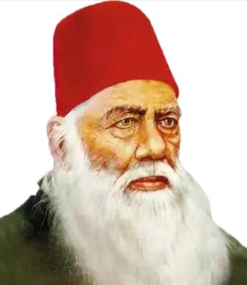
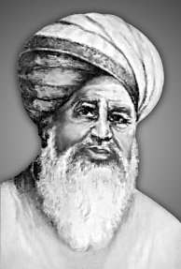
Key Reformers:
Syed Ahmed Khan
Haji Shariatullah

Slide 9
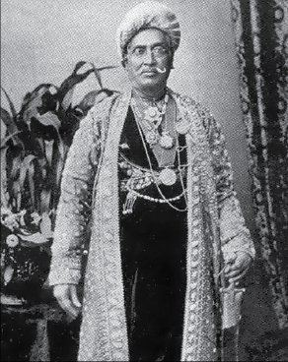
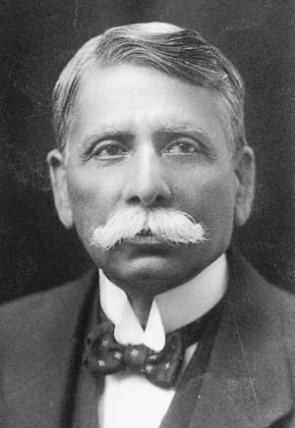
Nawab Abdul Latif
Syed Ameer Ali

Slide 10
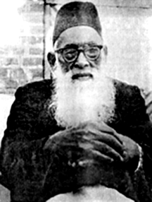
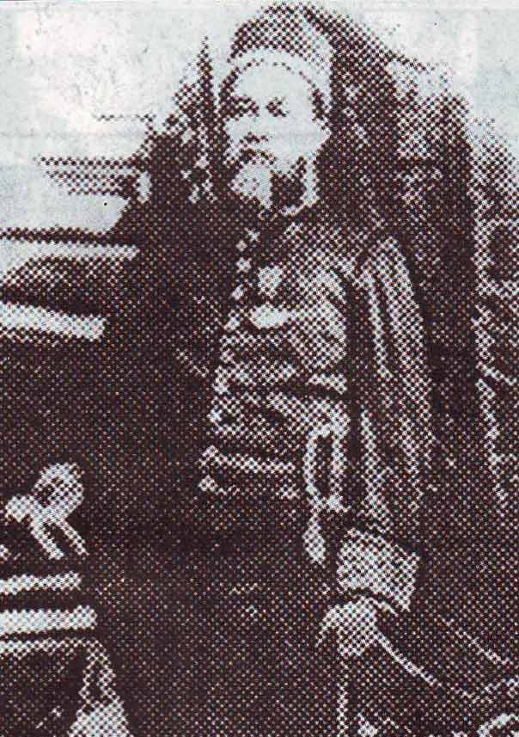
Khan Bahadur Ahsanullah
Sayed Nabab Ali Chowdhury

Slide 11
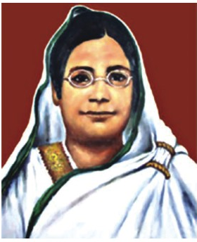
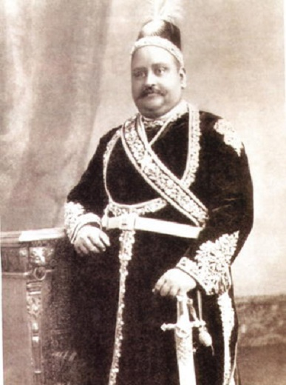
Begum Rokeya
Nawab Salimullah

Slide 12
Sayyid Ahmed Khan (1817-1898):
Sayyid Ahmed Khan devoted his entire life to the cause of promoting western education among the Muslim community in India. He first established a Translation Society in 1869 at Ghazipur in UP where he was posted as a government official. Through this society a large number of books and articles on various subjects were translated from English into Urdu and other Indian native languages. Later he established at Aligarh the Muhammadan Anglo-Oriental School in 1874 which was turned into a collage in 1878. It became the focal point of the Muslim renaissance in India. Like Rammohan Roy, he believed that religious doctrines should be examined by reason and commonsense and reevaluate in the light of contemporary knowledge and requirements.

Slide 13
Syed Ahmed’s political thought can be viewed in two phases: a) he appears to be a bold, liberal-minded and non-communal leader. During the time of the Sepoy mutiny he supported the British side, as he believed that the success of the sepoys would mean a return of medieval autocracy and feudalism. b) he maintained that it was through British rule that the people of India would be able to march toward modernization and the prospect of unprecedented development in future. He also believed that the Hindus and the Muslims of the country constituted in a real sense of one nation.

Slide 14
In his words, ‘íf united, we could support each other—if not, the effect of one community arraying itself against the other would tend to destruction of both’'.
Haji Shariatullah (1781-1840):
He was born in 1781 in a petty Talukdar family at the village Shamail under the then Madaripur sub-division of greater Faridpur district. He emigrated to Makkah in 1799, returned to Bangladesh in 1818 and started an Islamic revivalist reform movement, akin to the contemporary Arabian Wahhabism. The movement he started came to be popularly known as the faraizi movement. His reform movement was basically religious; but it touched upon various other aspects of the society. He may be characterized as an Islamic revivalist, a social reformer and a populist peasant leader.

Slide 15
He emphasized on holding correct faith in the Tawhid (Unity of Allah) and the Prophethood of Muhammad as well as on abstaining from associating any false gods and goddesses with Him (shirk).
Secondly, he laid extraordinary emphasis on performing the compulsory religious duties of Islam, by which he meant all necessary and mandatory duties, such as five times daily prayers (salat), payment religious taxes (zakat), fasting in the mouth of Ramadan (saum) and performance of Hajj, which are Faraiz and hence the movement was known as 'Faraiz'i'.
Besides, he emphasized the unity and brotherhood of the Muslims and equality of mankind; he condemned caste discrimination, which had contaminated the Muslim society.

Slide 16
He vehemently condemned numerous un-Islamic customs, usage and polytheistic accretions that had crept into the Muslim society by contagion of the practices of the non-Muslim neighbours.
Following the Wahhabi reforms of Arabia, he also condemned the performance of Fatiha, Urs and Milad, which were and still are popular social usage of the Muslims of the sub-continent, and tried to abolish them by stigmatizing them as bid'at (irreligious and sinful innovations). This evoked conservative reaction against his movement from the Muslim society around 1831 that resulted into a riot at Nayabari in the district of Dhaka.

Slide 17
He declared British India as a Dar- al- harb (an enemy state); in view of the inability to wage a war of freedom against the occupation power, he gave the lesser verdict that the absence of Muslim administration deprived the Muslims of Bengal from holding the congregational prayers of Juma' and Eids.
He declared that zamindars created under the Permanent Settlement had no right to a share of the agricultural crops produced by the Muslim tillers of the land. He instructed his followers not to participate in the Puja festivities of the polytheistic Hindu neighbours, pay any crop-levy imposed on them by the zamindars, besides the legal revenues fixed by the rent-roll of the government.

Slide 18
Rokeya Sakhawat Hossain (1880-1932):
She was a famous writer, poet, educationist, social reformer who played a pioneering role in awakening Muslim women during the colonial period of Bengal history. She was born on 9 December 1880 into a landed family of Pairaband in Rangpur.
Her father was a multi-lingual intellectual and was versed in Arabic, Urdu, Persian, Bangla, Hindi and English. But yet, he could not transcend the spirit of the time about women education. Like the rest of the society, Saber was also of the opinion that women should not receive education beyond the bounds of home. Therefore, Rokeya was not allowed to receive formal education, she learnt both Bangla and English at home with the help of her brothers. Her elder brothers and sister not only contributed to educating her, but also inspired her in writing.

Slide 19
In 1898, Rokeya was married to Syed Sakhawat Hossain, an Urdu-speaking man from Bhagalpur in Bihar. A deputy magistrate, Sakhawat Hossain was liberal and progressive, and encouraged his wife to study both Bangla and English and also inspired her to read literary works from home and abroad and she took the fullest advantage of the liberality of her husband. Besides reading the existing literature in Bangla very extensively, she also took to writing at the same time. Unfortunately, Roquiah had a short conjugal life. Her husband died on 3 May 1909. She had two daughters, but they died in infancy.

Slide 20
Rokeya realized that women could be freed from their shackles only if they were educated and became independent economically. On 1 October 1909, she started a school for Muslim girls at Bhagalpur with only five students, naming it after her husband, Sakhawat Memorial Girls' School. However, she could not continue at Bhagalpur for domestic reasons and decided to move to Calcutta.
At Calcutta she set up Sakhawat Memorial Girls' School in a house at 13, Waliullah Lane on 16 March 1911 with eight students. The school was upgraded to Middle English Girls' School in 1917 and to High English Girls' School in 1931, and all through the untiring efforts of Rokeya.

Slide 21
Rokeya Sakhawat Hossain founded an organisation called Anjuman-e-Khawatin-e-Islam, or the Muslim women's society, in 1916 to make women aware of their rights. The society was in the forefront of the fight for women's education, employment and their legal and political rights. The organisation defrayed the cost of education for a large number of girls and arranged marriages for many poor girls. It gave shelter to orphans and the destitute and extended financial help to widows. It also established some businesses for women to earn economic independence.

